Slide 1


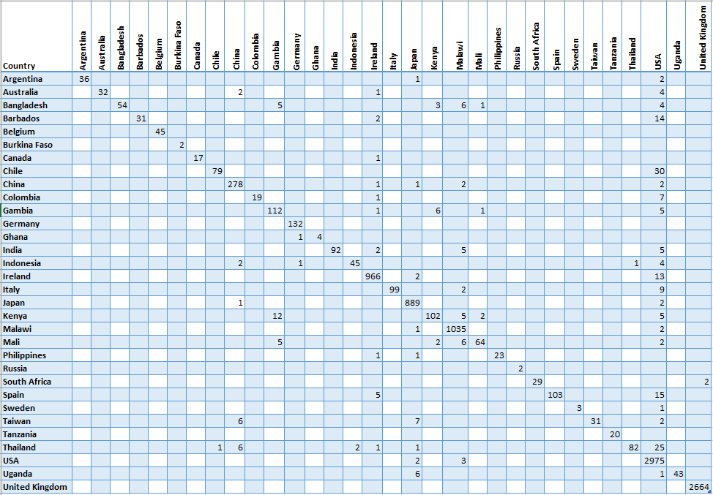
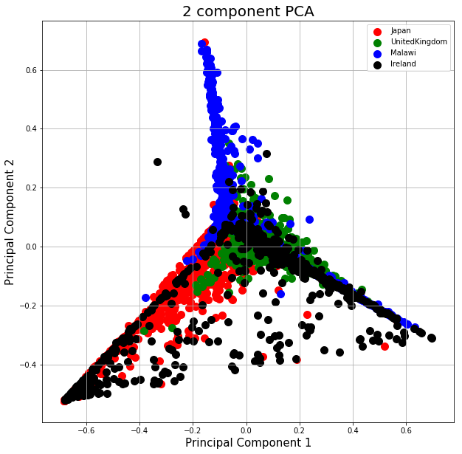
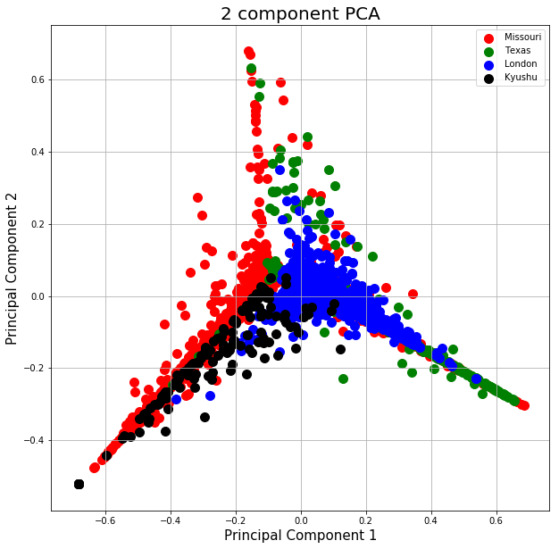
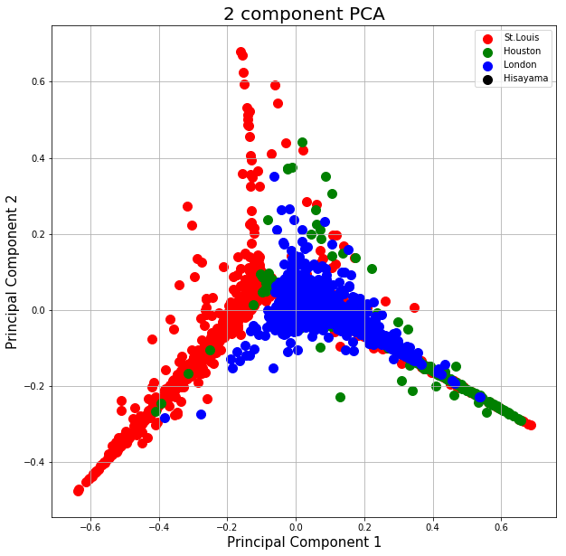
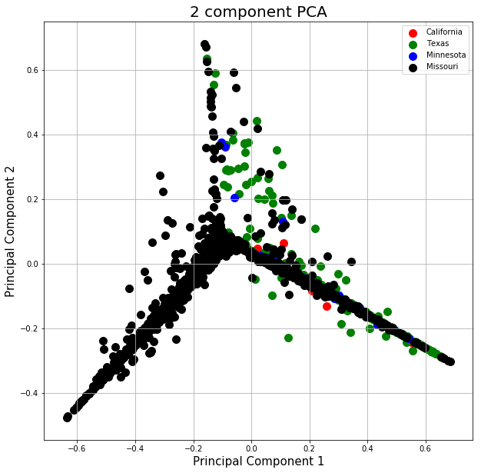
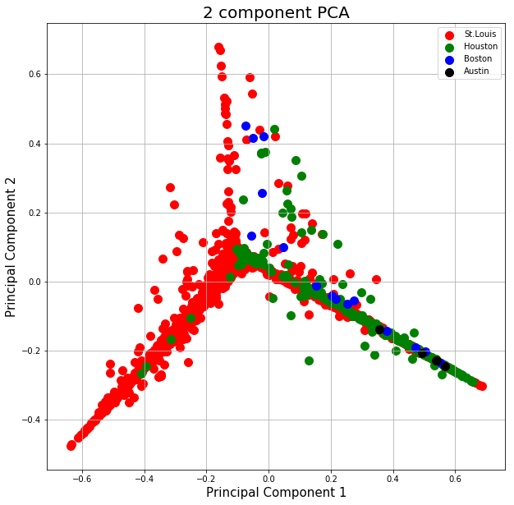
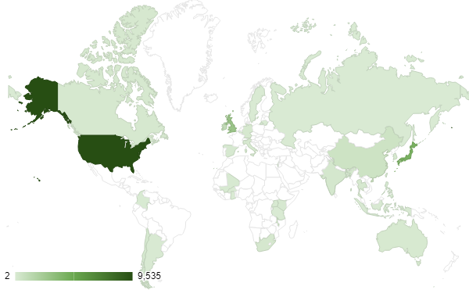
Using Human Microbial Data to Predict Geographical Location
Alex Rojas, Leshan Viswanath and Dr. Harinder Singh, PhD
J. Craig Venter Institute
Random Forest
The Random Forest is a model consisting of many decision trees
Random Forest uses a random sampling of training data points
when building trees and random subsets of features considered when splitting nodes
While training, each tree learns from a random sample of the data
These samples are bootstrapped, meaning the samples are drawn with replacement, resulting in some samples being used multiple times in a single tree
Below is an explanation of the process that we went through in writing our model
Results
Abstract
Figure 2 shows the scores from classification
Background: Current advancements in technology have allowed for the improved study and facilitated a deeper understanding of the complex human microbiome, enabling us to predict diverse physiological states as a function of the makeup of microbial communities around the body. We achieve this by implementing machine learning (ML), an Artificial Intelligence technique that constructs models according to patterns in data and then optimizes. We were able to make microbiome predictions of varying scopes of geography including cities, states or provinces, and countries. Method: In the Python Programming Language, we utilized the Scikit-learn ML Library to successfully build models that predicted the city, state, and country of human microbiome samples collected from various body sites. These Forensic Microbiome Database samples were 16s rRna Illumina and 454 Sequence Reads that were clustered to Operational Taxonomic Units and assigned taxonomy with the UPARSE algorithm and Mothur, respectively. Primarily, we focused on the Random Forest method to predict geographical provenance. Result: The Random Forest model that we built performed well, scoring greater than 95% accuracy. However, we did run into various errors throughout the process of building the model. Through various troubleshooting mechanisms we were able to improve performance slightly.
Conclusion: After performing this test, we were able to identify the best specifications that can be added to our model to produce accurate predictions. Due to current computational restrictions, we weren’t able to test the models as extensively as we would have liked. In the future, we plan on testing the models more extensively to improve predictions.
Figure 3. Confusion Matrix
Figure 4. Country
Loaded in Stool data
Extracted the data into useable variables
Split the data using train test split
Built the Mode
Wrote predictions into a file
Wrote in performance indicators
Added GridSearchCV
Figure 5. State
Below is an explanation of ways we quantified the performance of our models, and an explanation of how it functions
F1 Score
F1 Score is the harmonic mean of Precision and Recall
This score takes both false positives and false negatives into account
MCC Score
Known as Matthews correlation coefficient
It takes into account true and false positives and negatives
n is the total number of observations
Introduction
A microbiota is a community of microorganisms that live inside a host all over the body, and the composition of such a community can include viruses, bacteria, fungi, and other microbes. The “microbiome” refers to the collective genome of these species, and it can be read using sequencing technology such as Illumina. In this project, we sought to find an efficient and accurate model that can make predictions of geographical location based upon data from the Forensic Microbiome Database on microbial data of composition and site. By the end of the project, we hoped to have a clear understanding of not only which model was the best at making predictions, but also as to why the model was so successful. Building models to make predictions is important because it could allow us to detect the prevalence of certain microorganisms in regions. For instance, if a model predicts that a region, based upon a multitude of factors, is at high risk for a type of viral infection, we could take early action to prevent the virus from spreading and causing damage. Furthermore, this method could infer information about forensic suspects based on microbial compositions in the future.
Accuracy Score
It is the number of correct predictions made divided by the total number of predictions made
This function computes subset accuracy
Precision Score
Precision is the ratio of correctly predicted positive observations to the total predicted positive observations
Figure 6. City
Recall
Recall is the ratio of correctly predicted positive observations to the all observations in actual class - yes
Figure 1 shows the geographical locations of the stool data.
Figure 7. US State PCA
Figure 8. US Cities PCA
Conclusion
Conclusion in Analysis
In our analysis we learned that using a classification based Random Forest produces the most accurate predictive classifications of microbiome data by geographical provenance. Our research, showed us that Random Forest is the best model to use when trying to make predictions on microbiome data.
Methodology
Initially, we started off by researching the different ML methods such as Classification, Regression, and Tree-Based. We first looked into classification method, which categorically assigns predictions to a collection of data. Next, we researched Regression models, which examine the influence of one or more independent variables on a dependent variables. Tree based models which are used when dependent variable is continuous.
Future Testing
In future testing, we plan on running our model with larger sets of microbial data. In doing this, we will be able to test the capabilities of our model and optimize for better predictions.
References
Scikit-learn: Machine Learning in Python, Pedregosa et al., JMLR 12, pp. 2825-2830, 2011.
/@tonester524. (2019, August 4). Understanding Random Forest. Retrieved from https://towardsdatascience.com/understanding-random-forest-58381e0602d2
J. D. Hunter, "Matplotlib: A 2D Graphics Environment", Computing in Science & Engineering, vol. 9, no. 3, pp. 90-95, 2007.
Most instances occurred in the United States, Great Britain, and Japan.

